Slide 1
Introduction Video
Smart Systems for Occupancy and Building Energy Control
version 3
Team:Eduardo Castillo Mentor: Ali Mostafavi, Leonardo Bobadilla

Slide 2
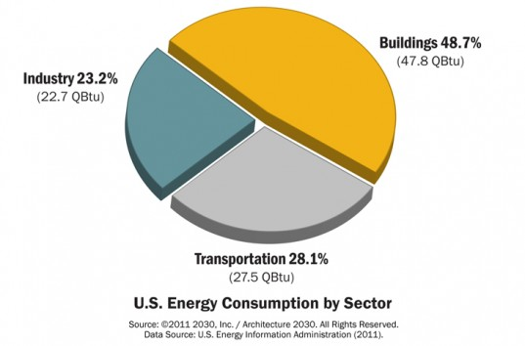
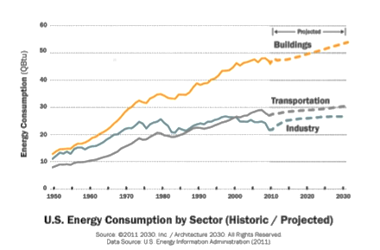
Problem Definition

Slide 3
Current system limitations
The current system predicts energy waste using simulated data, not real world data.
No way to tell if someone enters or exits a zone.
Wasteful Infrared sensor to only COUNT people going in and out of rooms with little scalability.

Slide 4
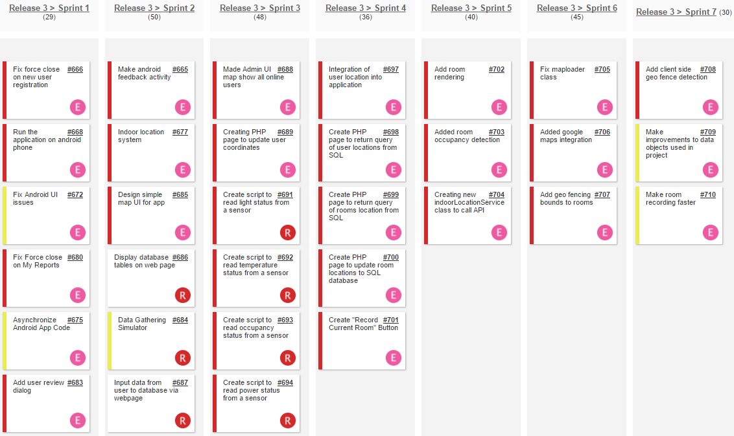
User Stories Implemented

Slide 5
SSOBEC #683- Add user review dialog
USER STORY DESCRIPTION: As a user, I need to be able to rate how comfortable I am in the current zone/room
ACTORS:
User
PRE-CONDITIONS:
User is logged in.
User is main screen.
User selects “Rate current zone conditions” button.
DESCRIPTION:
Use case begins when the User clicks on the “Rate current zone conditions” button in my myZonesView.
The System responds by greeting the user with a rating dialog box for gathering user input on current zone conditions.
Use case ends when the User submits their rating.

Slide 6
SSOBEC #677- Indoor Location
USER STORY DESCRIPTION: As a user I want to know what zone I’m currently in or if there are any zones around me that are wasting energy.
ACTORS:
User
Admin
PRE-CONDITIONS:
User is logged in.
User is main screen.
User has toggled indoor location tracking through settings menu.
User selects swipes from left to right on bottom half of main screen.
DESCRIPTION:
Use case begins when the User is logged into the system and swipes from left to right on main screen.
The System responds by polling indoor location and updating google map view.
Use case ends when the User is able to see their location in the google map view.

Slide 7
SSOBEC #701 -Add Room for geo fence
USER STORY DESCRIPTION: As an admin, I would like to add boundaries for rooms I want to show up on the indoor map of the building.
ACTORS:
Admin
PRE-CONDITIONS:
Admin is logged in.
Admin is main screen.
Admin has toggled indoor location tracking through settings menu.
Admin selects the “Record Current Room” Button
DESCRIPTION:
Use case begins when the Admin is logged into the system and selects the “Record Current Room” Button.
The System responds by polling indoor location and bringing up a dialog confirming the room record selection.
Use case ends when the Admin selects update and is returned to the main screen.

Slide 8
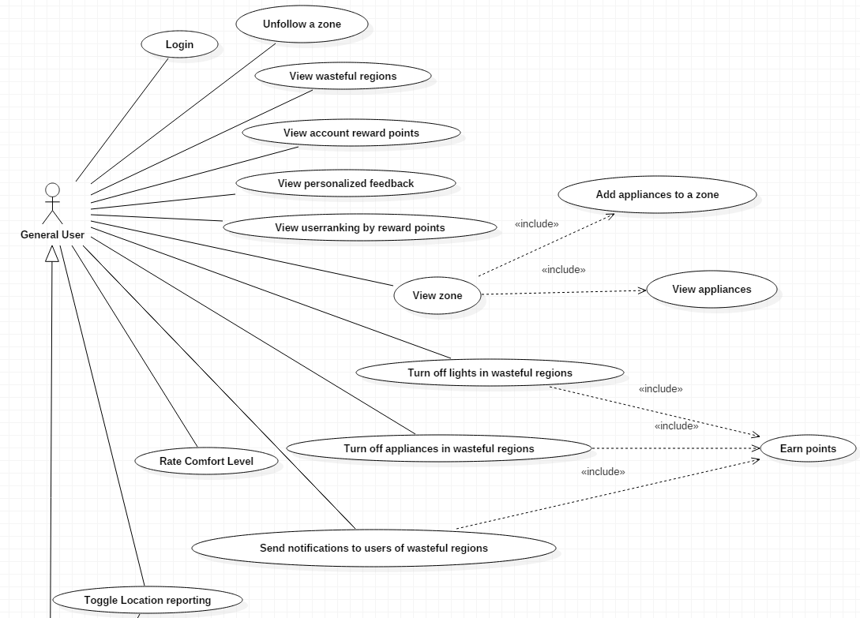
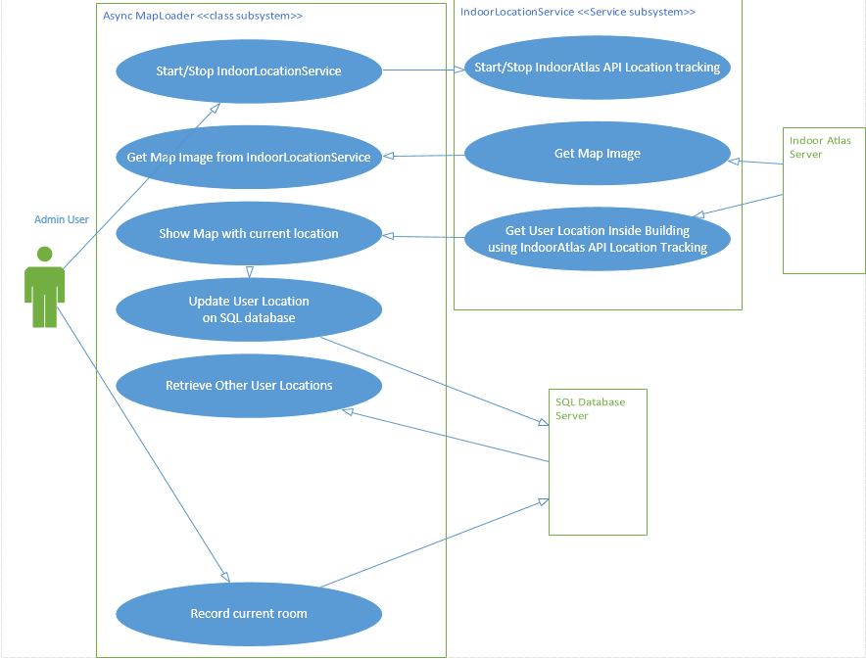
UML Use Case Model

Slide 9
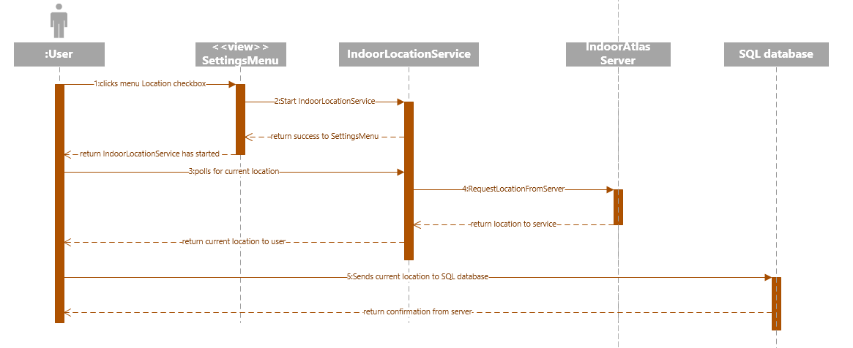
UML Sequence Diagram (Indoor location)

Slide 10
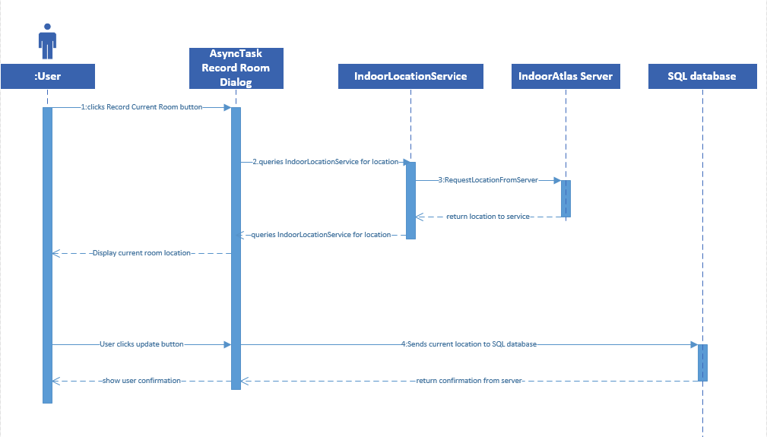
UML Sequence Diagram (Add Room for geo fence)

Slide 11
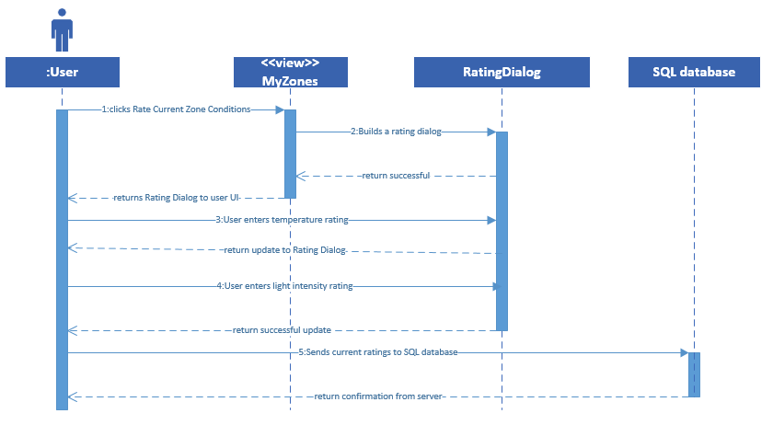
UML Sequence Diagram (Add user review dialog)

Slide 12
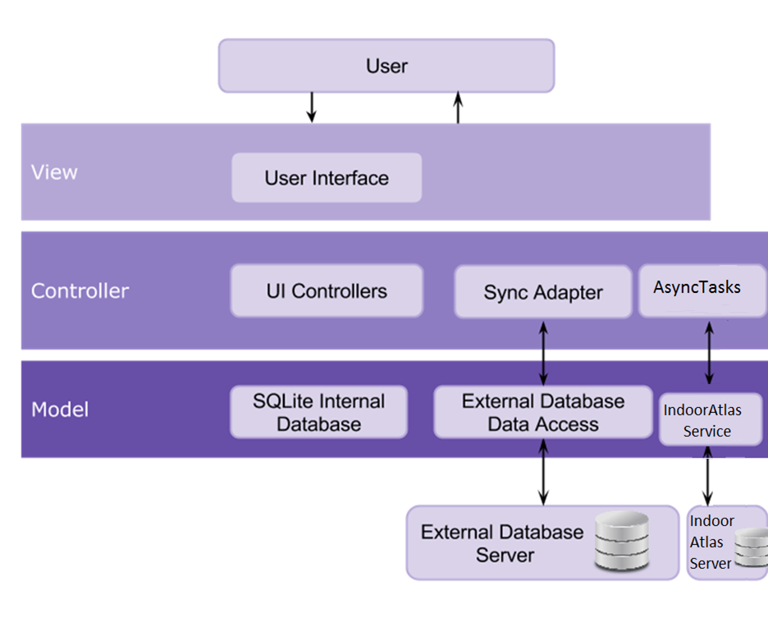
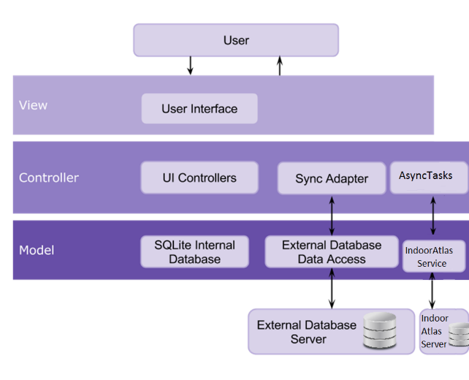
System Design

Slide 13
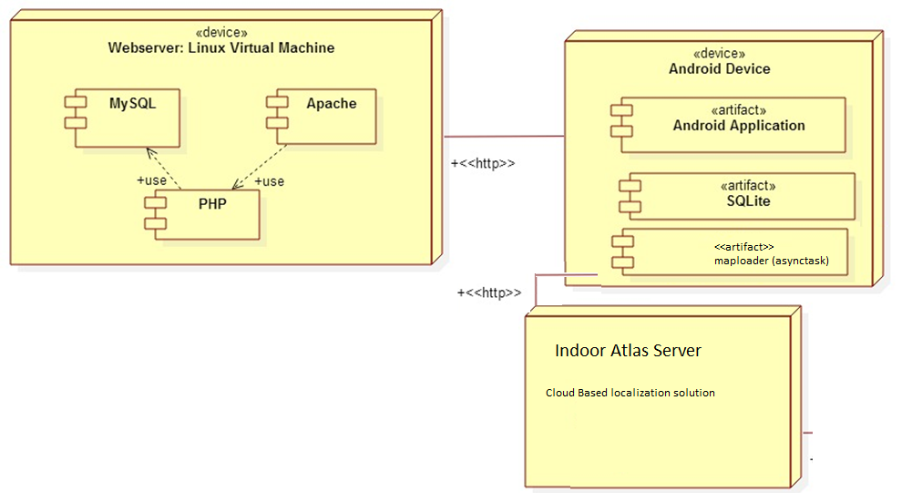
System Deployment

Slide 14
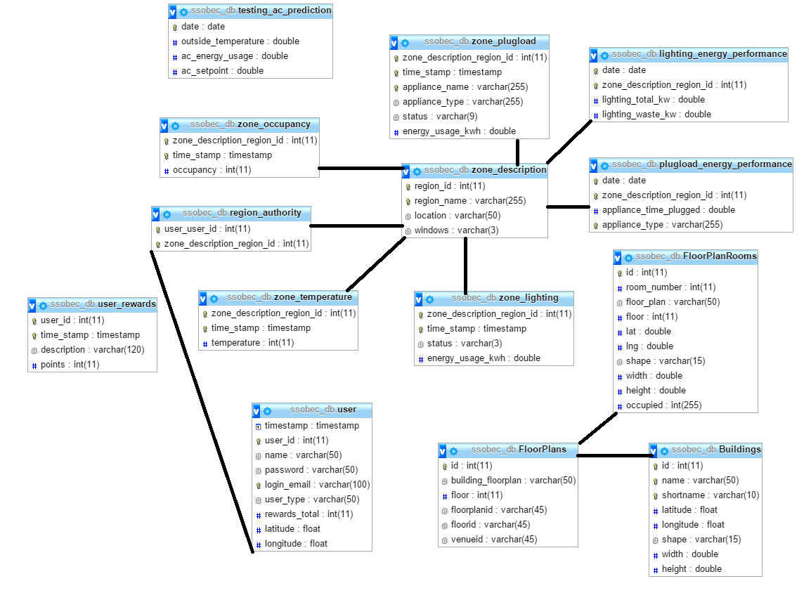
Persistent Data Design

Slide 15
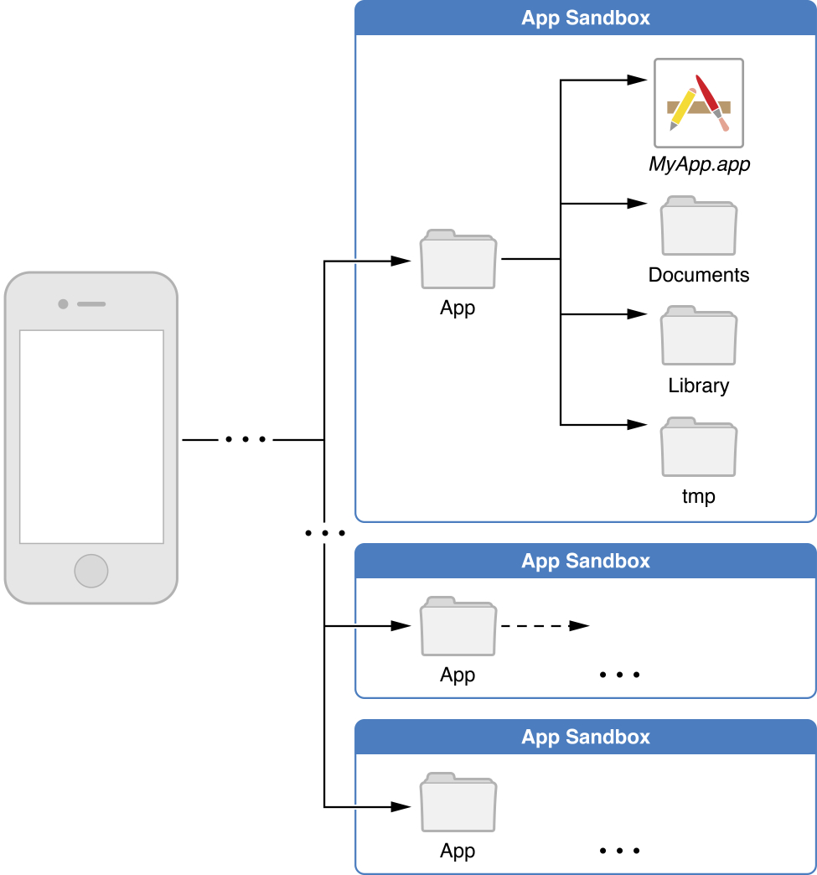
Security/Privacy

Slide 16
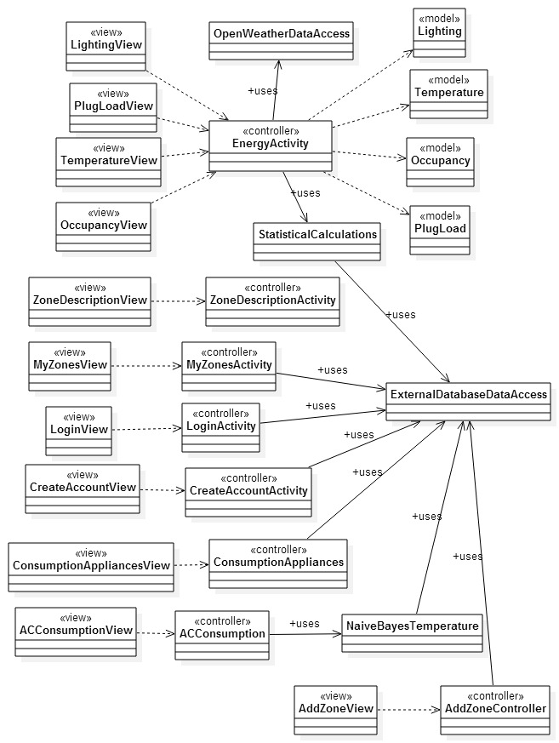
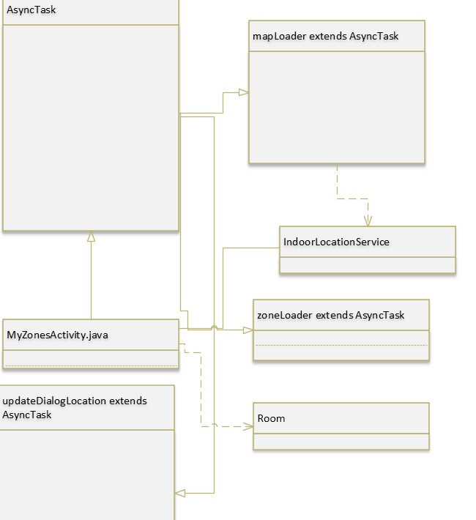
Minimal Class Diagram

Slide 17
State Machine
Stopped
onDestroy()
Destroyed
onStop ()
Paused
onResume ()
onResume ()
onPause()
Activity
Running
onCreate()
onResume()

Slide 18
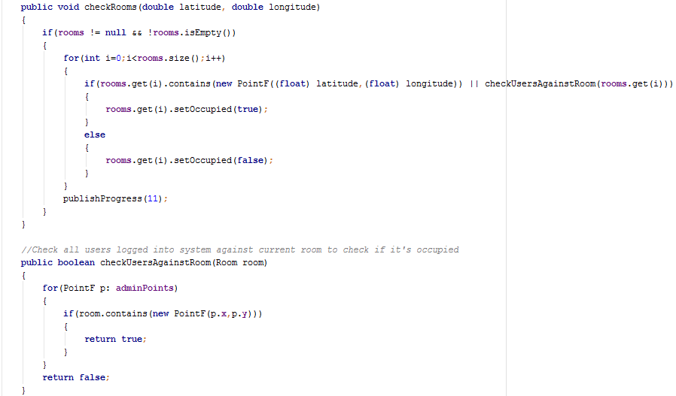
Main algorithm used for detecting occupancy in rooms
Algorithm steps
checkRooms gets called with a latitude and longitude to check against all rooms.
If the list of rooms is not null and not empty start checking current lat and lng against rooms in that list.
Compare user’s coordinates as a PointF object against a RectF object in each Room object.
Also compare other online user’s location to each room.
If the room’s RectF contains the point, mark it as occupied and publish the progress after looping through all rooms.

Slide 19
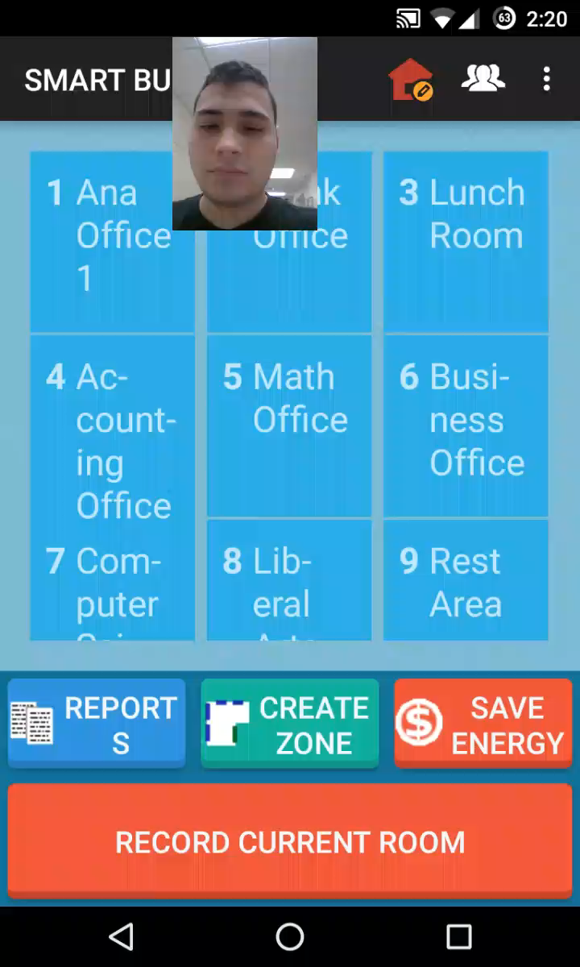
High level Demo

